Slide 1

Bitcoin: A Technical Analysis
Jared.m.murphy@protonmail.com
linkedin.com/in/jared-m-murphy/
github.com/jared-m-murphy

Slide 2

What is Bitcoin?
The Bitcoin Network is a decentralized self-auditing encrypted ledger of debits and credits
Bitcoin is the crypto asset that is debited and credited to different addresses on the ledger
The Bitcoin Network is open source and global in nature
Digital Gold/Gold 2.0

Slide 3
Historical Price Action of Bitcoin

Slide 4
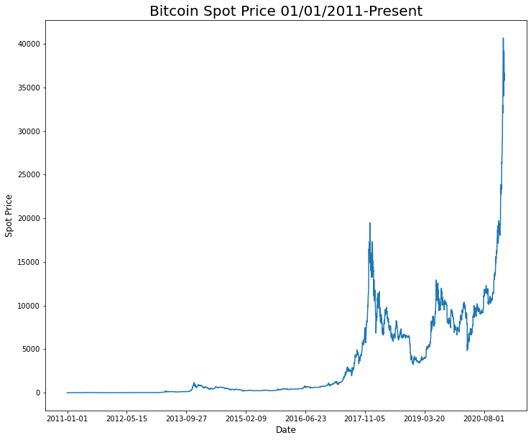

Slide 5
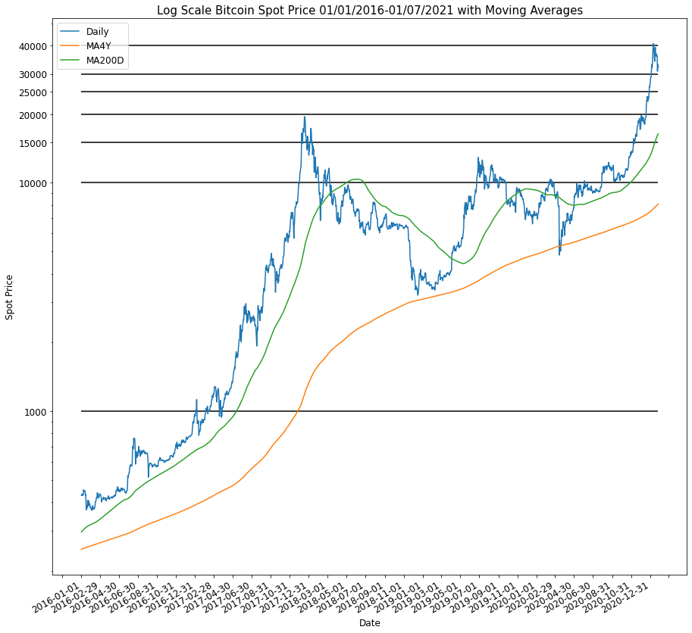

Slide 6
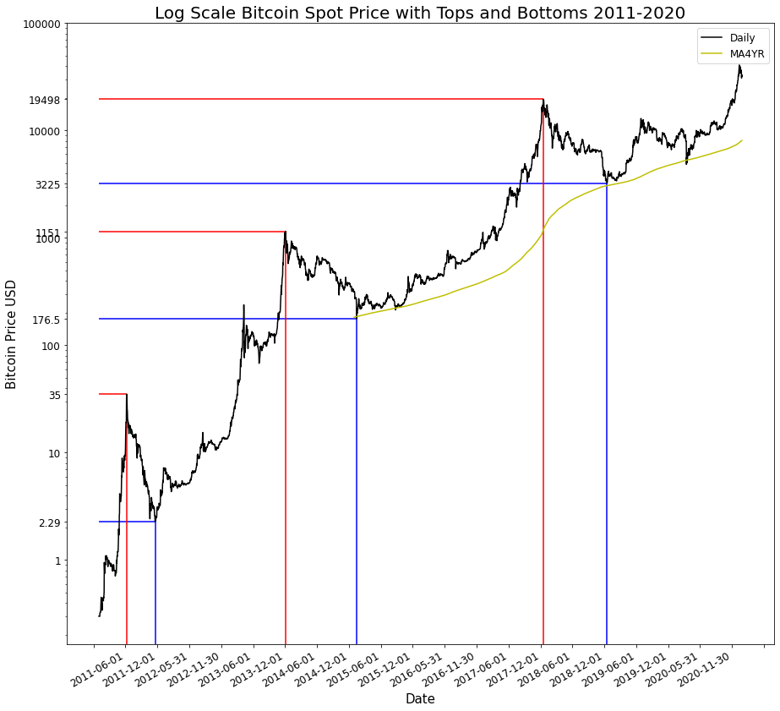

Slide 7
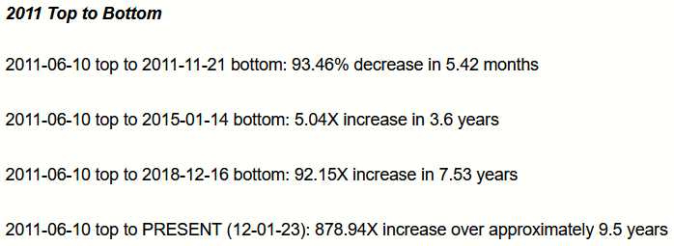
2011 Top to Bottom

Slide 8
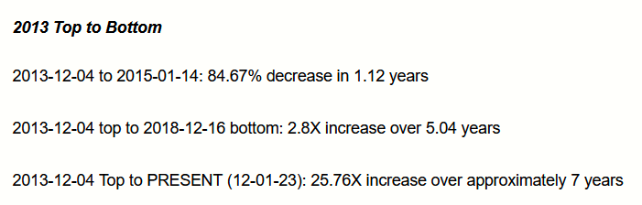
2013 Top to Bottom

Slide 9
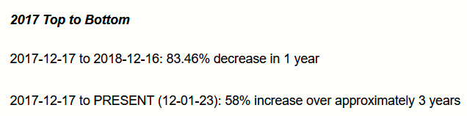
2017 Top to Bottom

Slide 10
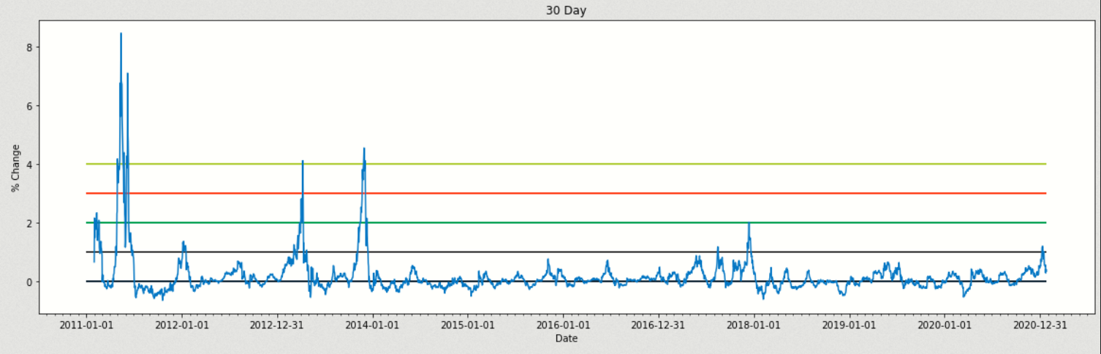
30 Day % Change BTC Price USD 2011-Present (1/25/21)

Slide 11
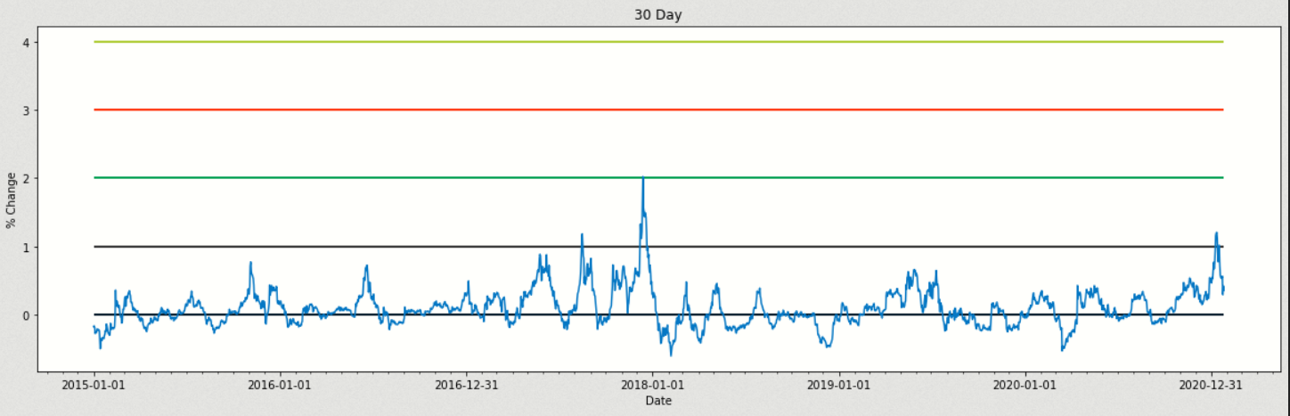
30 Day % Change BTC Price USD 2015-Present (1/25/21)

Slide 12
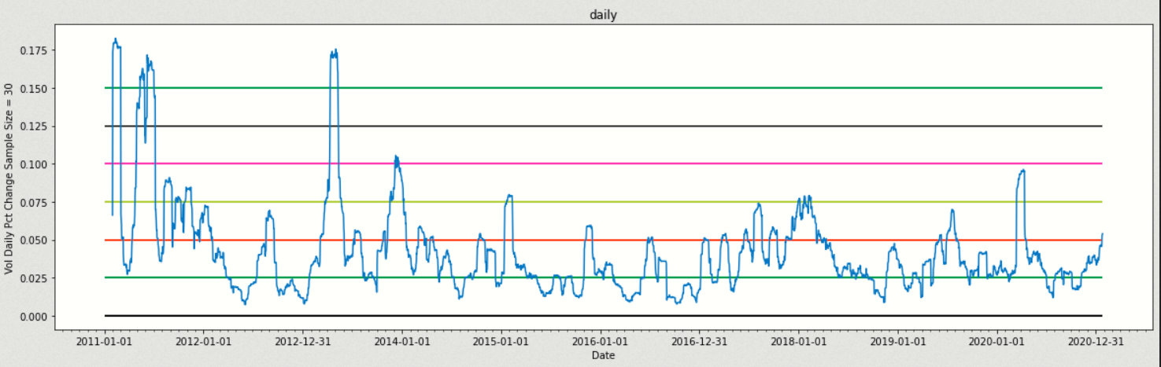
Rolling Volatility in Daily % Change 2011-Present (1/25/21)
Sample Size = 30

Slide 13
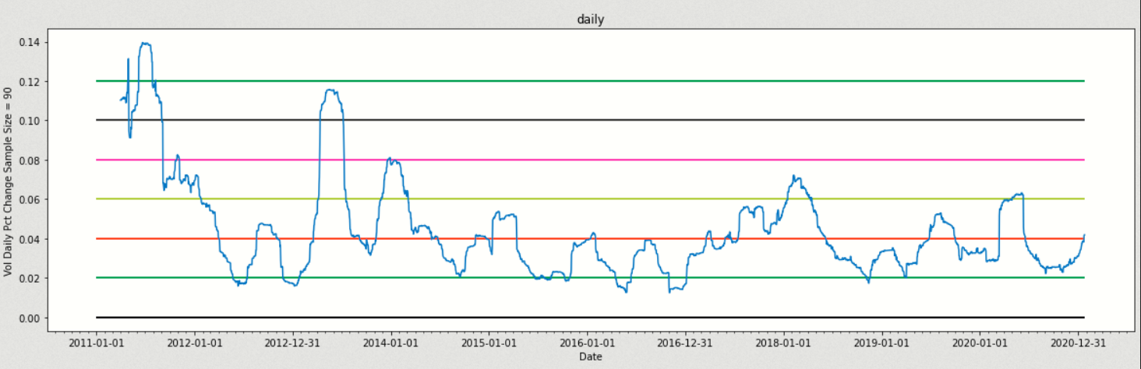
Rolling Volatility in Daily % Change 2011-Present (1/25/21)
Sample Size = 90

Slide 14
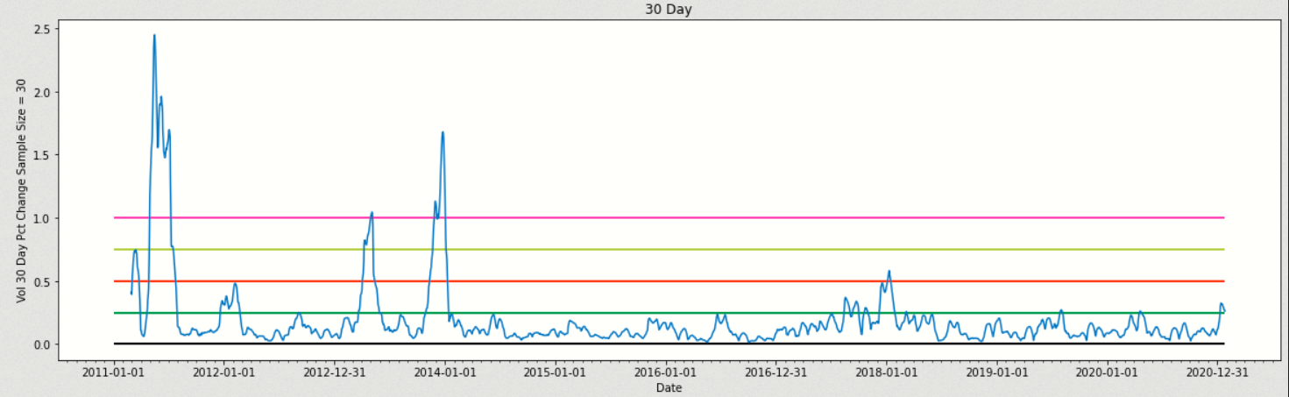
Rolling Volatility in 30 Day % Change 2011-Present (1/25/21)
Sample Size = 30

Slide 15
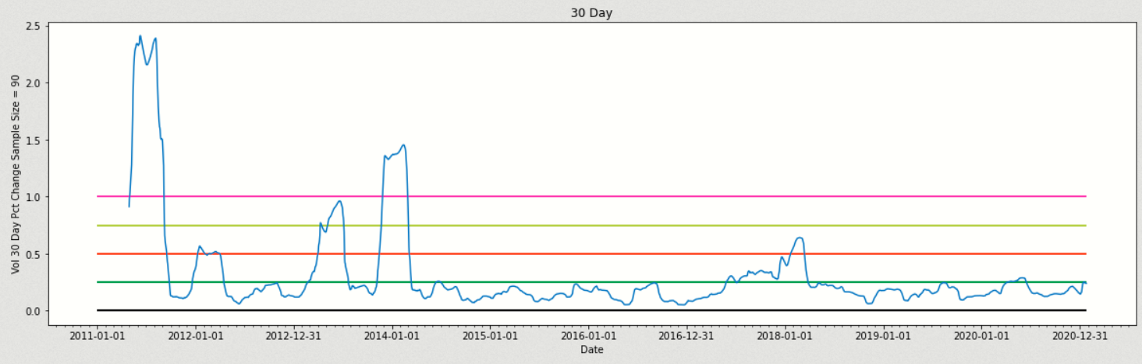
Rolling Volatility in 30 Day % Change 2011-Present (1/25/21)
Sample Size = 90

Slide 16
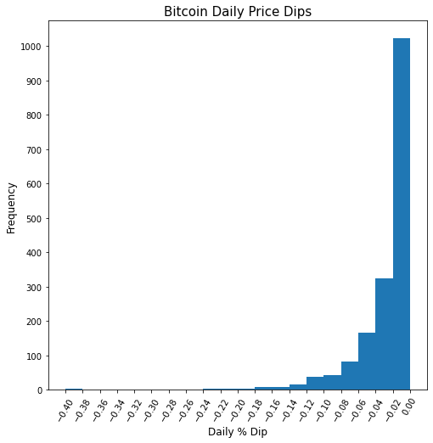

Slide 17
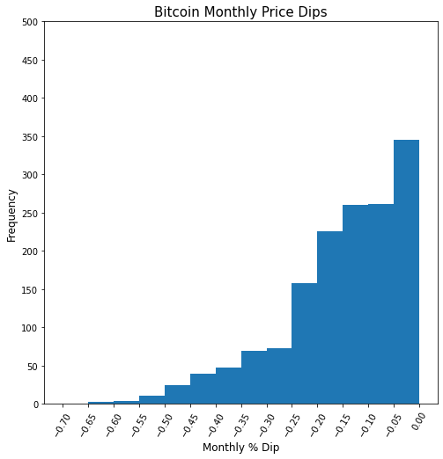

Slide 18
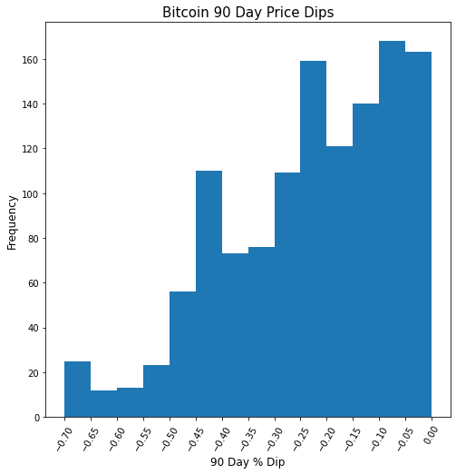

Slide 19
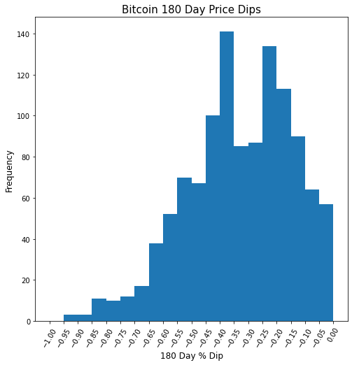

Slide 20
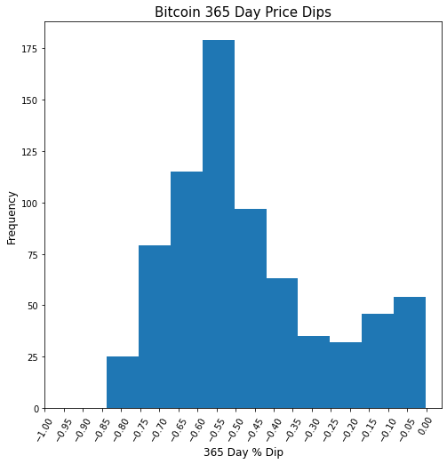

Slide 21
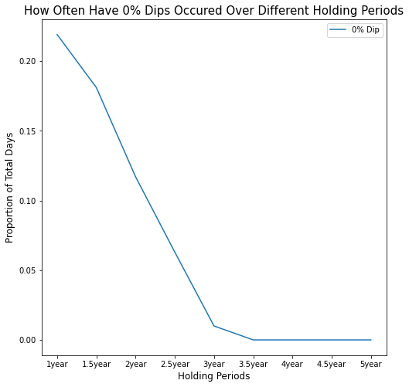

Slide 22
Bitcoin Halving's and Supply

Slide 23
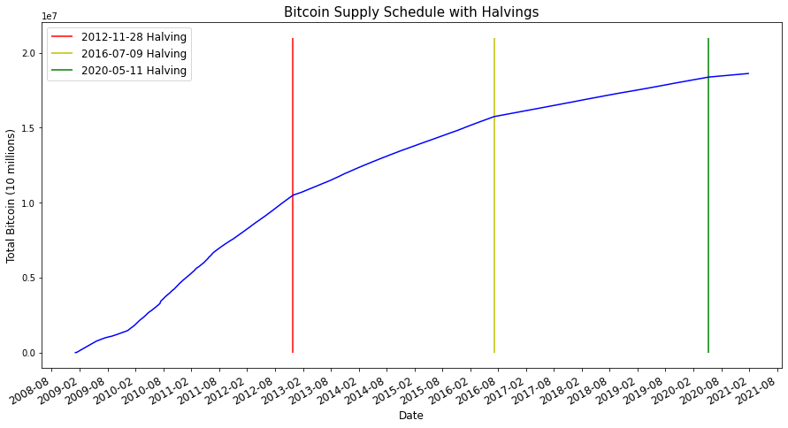
Bitcoin Supply Schedule
Every four years, on average, the daily supply of new bitcoin is cut in half. These events are built into the Bitcoin protocol and are called “Halvings”. The halvings will continue until 2140, when the final bitcoin will be created. The total number of Bitcoin to be created will be 21million.

Slide 24
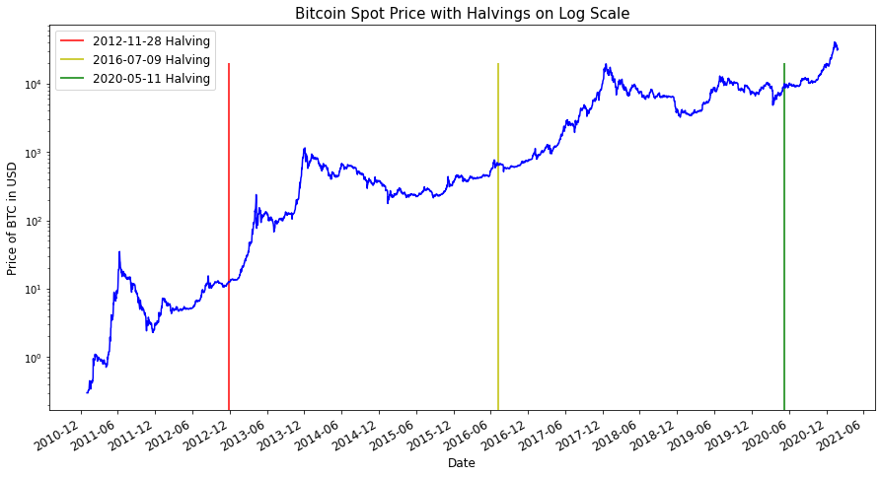

Slide 25
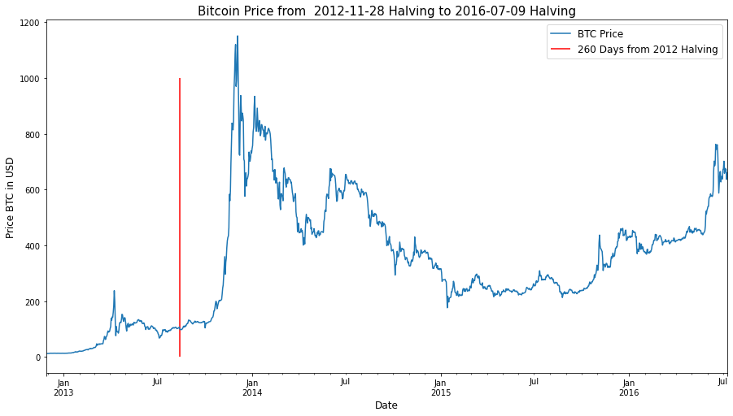

Slide 26
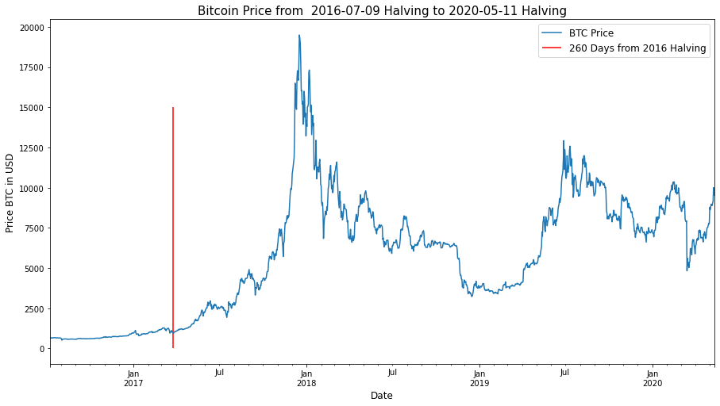

Slide 27
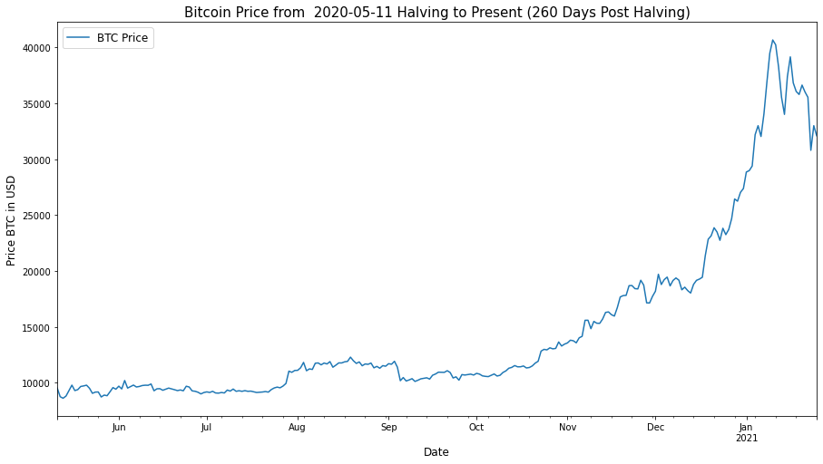

Slide 28
Bitcoin Returns and Volatility Vs. Other Asset Classes
Precious metals

Slide 29
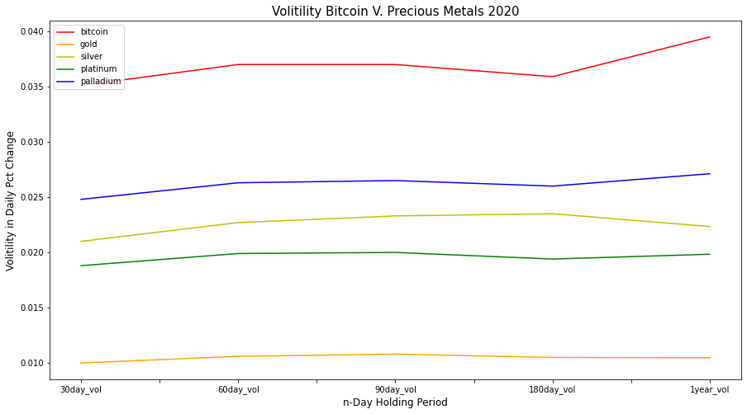
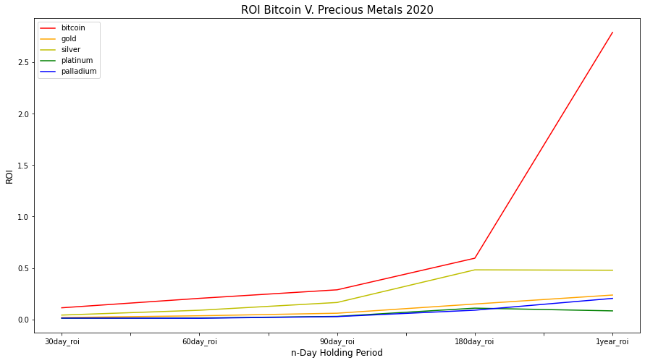
2020 Bitcoin V. Precious Metals

Slide 30
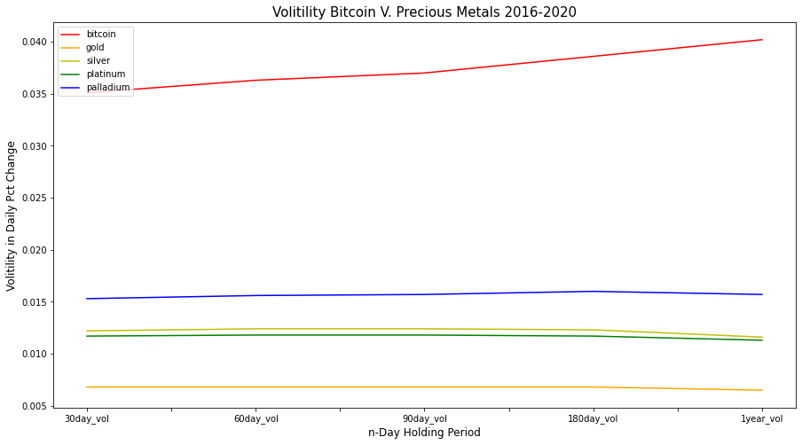
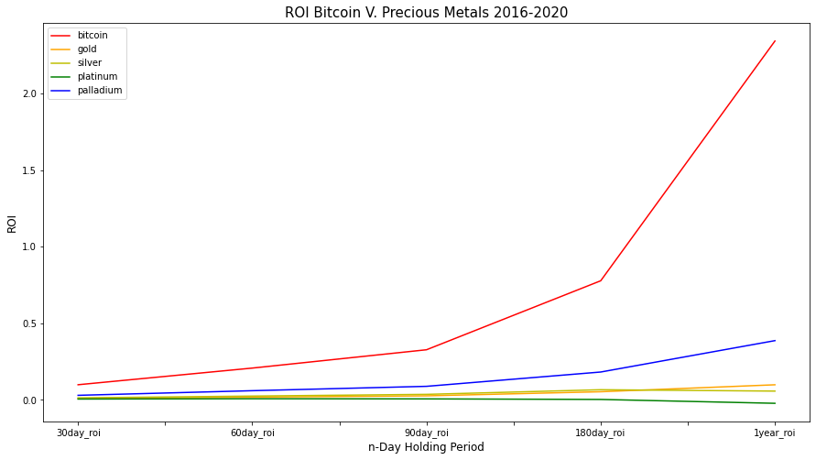
2016-2020 Bitcoin V. Precious Metals

Slide 31
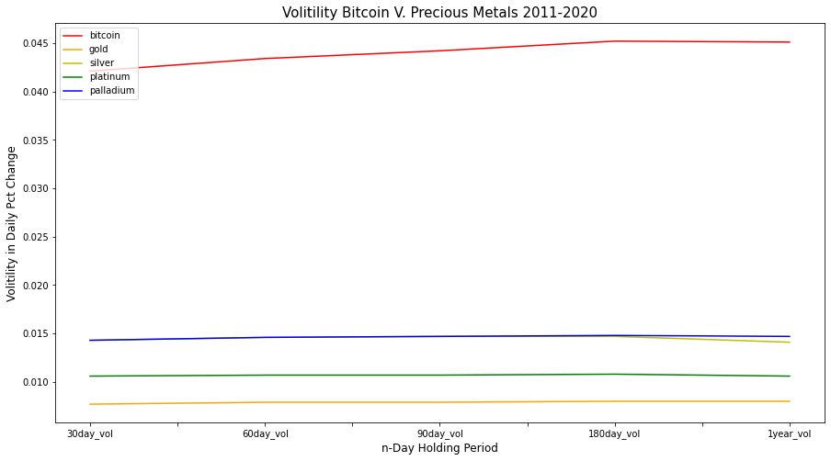
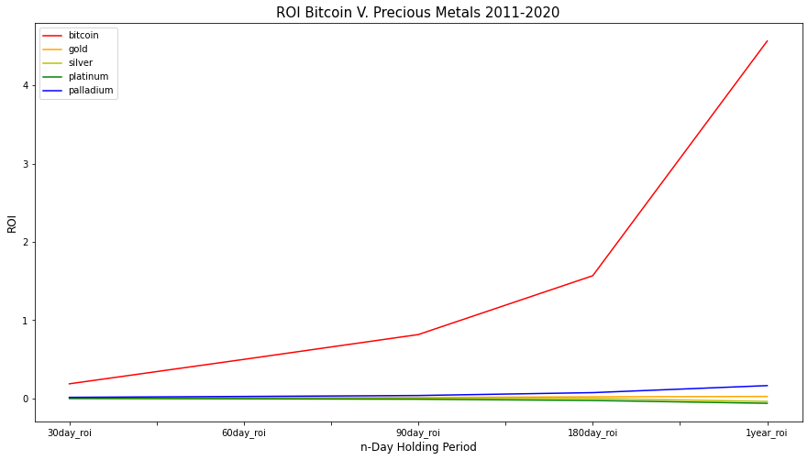
2011-2020 Bitcoin V. Precious Metals

Slide 32
Bitcoin Returns and Volatility Vs. Other Asset Classes
FaANGT Stocks

Slide 33
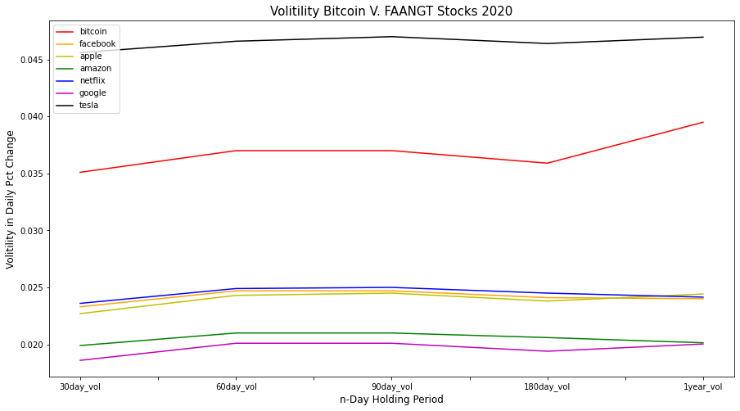
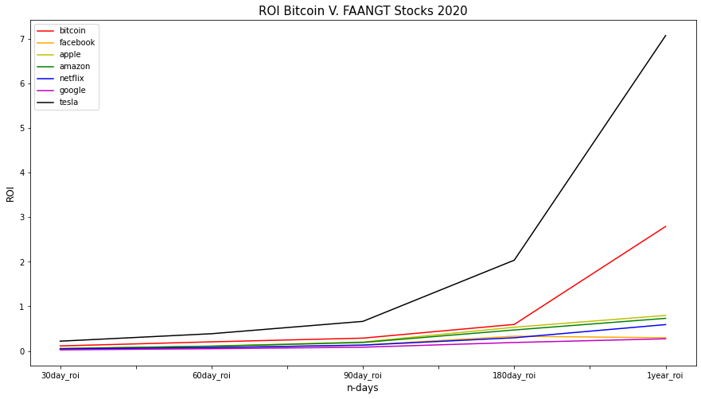
2020 Bitcoin V. FAANGT Stocks

Slide 34
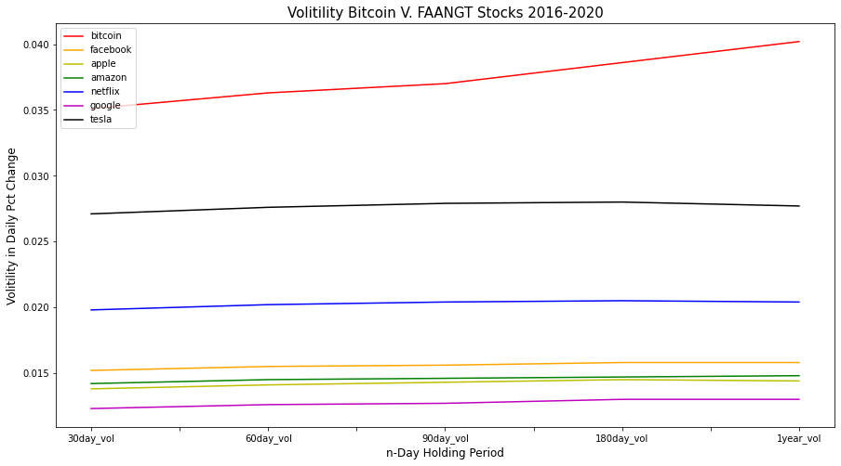
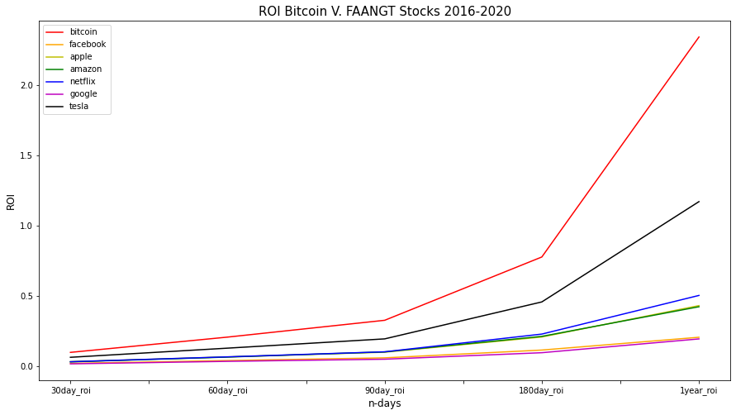
2016-2020 Bitcoin V. FAANGT Stocks

Slide 35
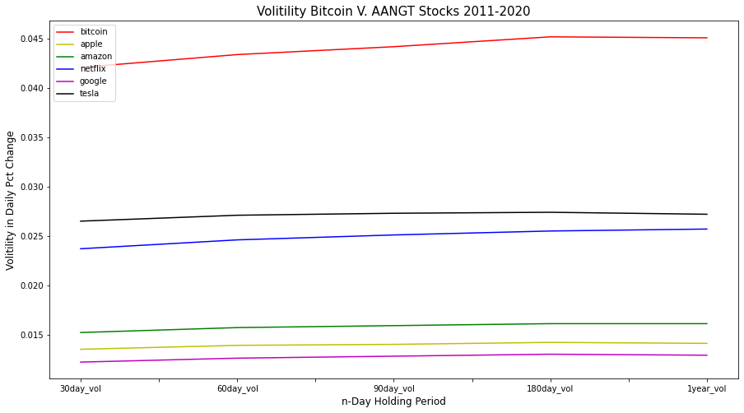
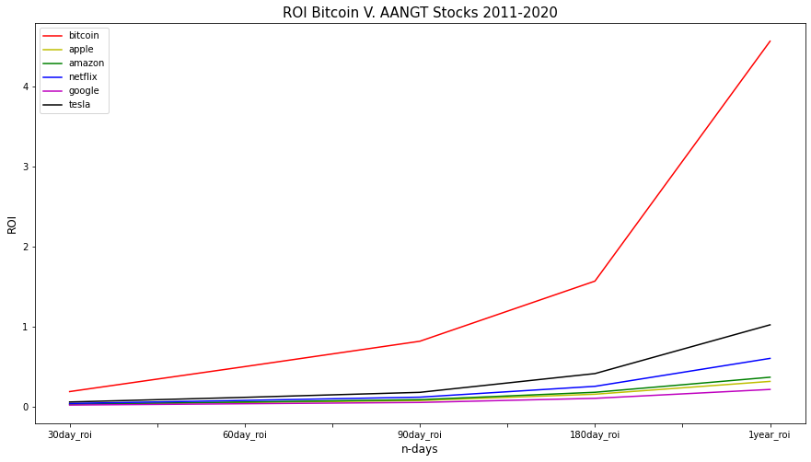
2011-2020 Bitcoin V. FAANGT Stocks

Slide 36
Bitcoin V. the Entire S&P 500
2020
Bitcoin in 89th Percentile for volatility
Bitcoin in 99.06th Percentile for returns
2016-2020
Bitcoin in 99.6th Percentile for average annual volatility
Bitcoin in 99.8th Percentile for average annual returns
Using a computer algorithm in python, bitcoins volatility and returns were compared to the S&P 500

Slide 37
Bitcoin Volatility Vs. Other Asset Classes
United States Treasuries

Slide 38
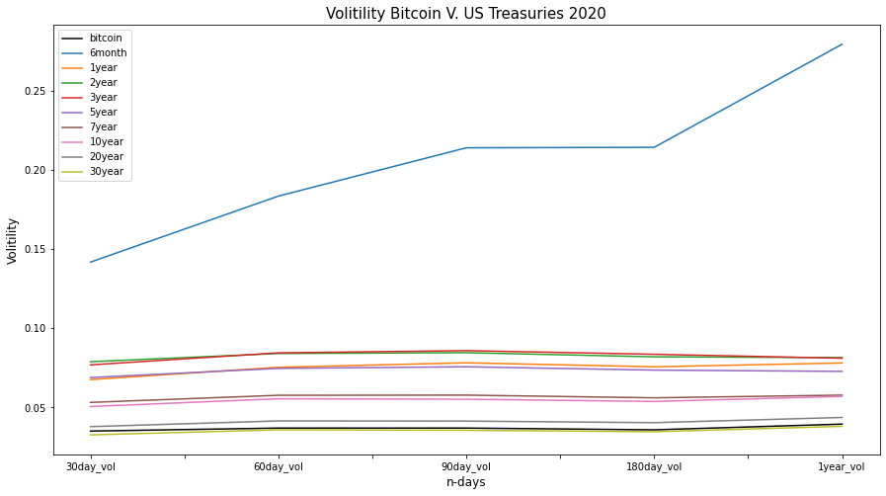
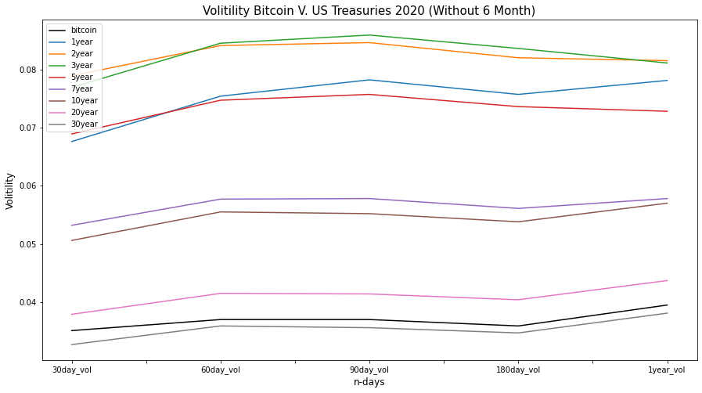
2020 Bitcoin V. US Treasuries

Slide 39
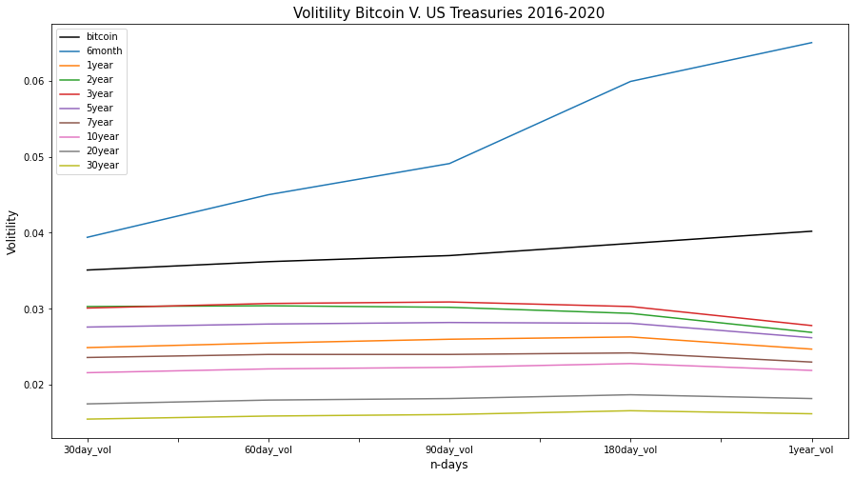
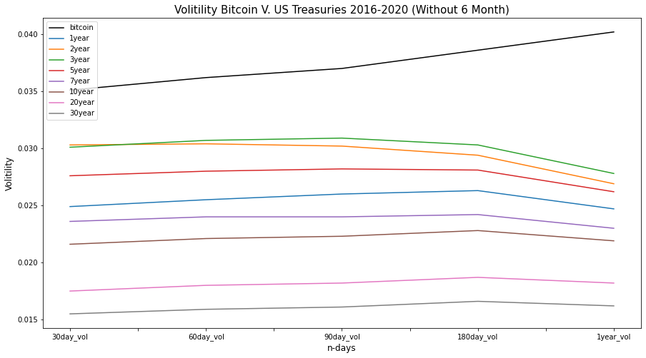
2016-2020 Bitcoin V. US Treasuries

Slide 40
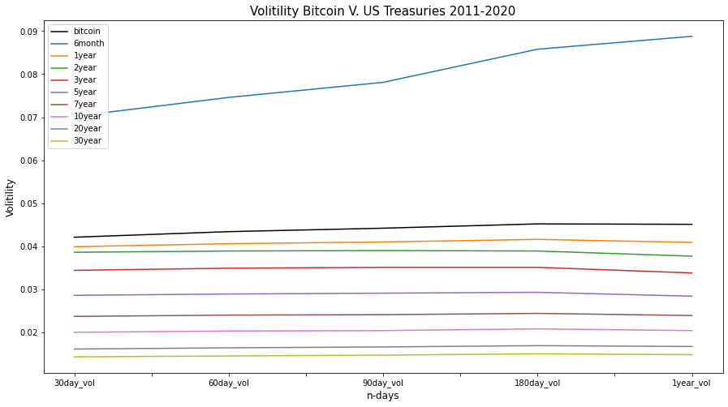
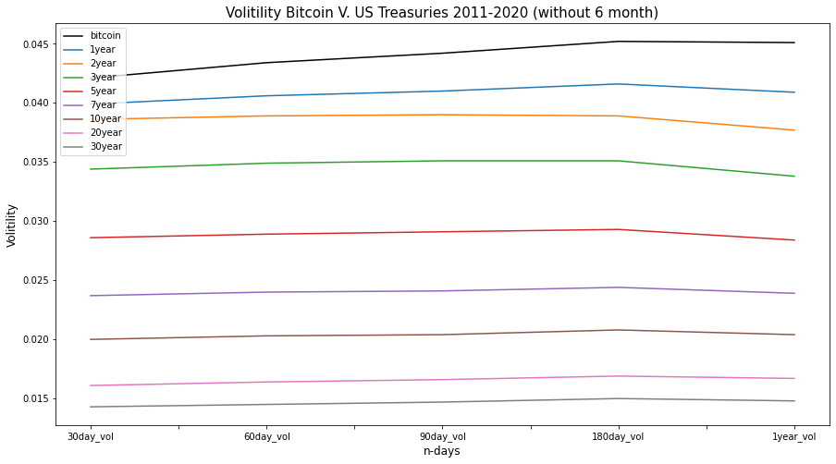
2011-2020 Bitcoin V. US Treasuries

Slide 41
Bitcoin Volatility Vs. Other Asset Classes
Commercial real estate

Slide 42
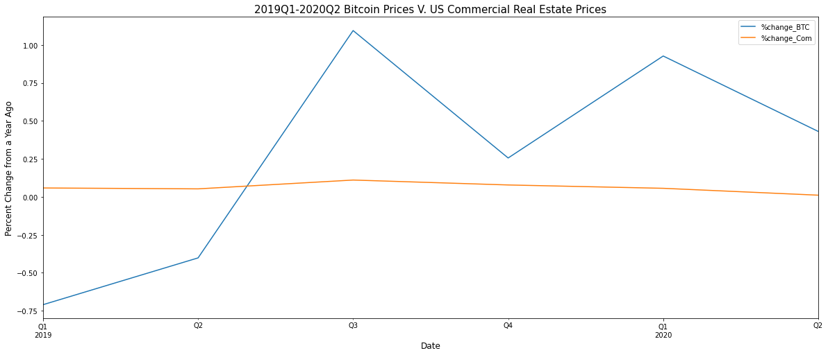
2019Q1-2020Q2 Bitcoin V. US Commercial Real Estate

Slide 43
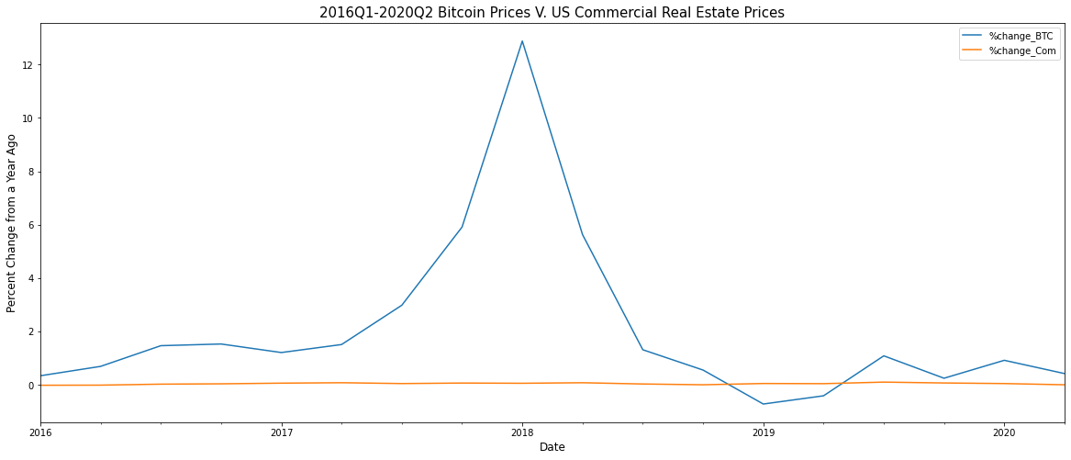
2016Q1-2020Q2 Bitcoin V. US Commercial Real Estate

Slide 44
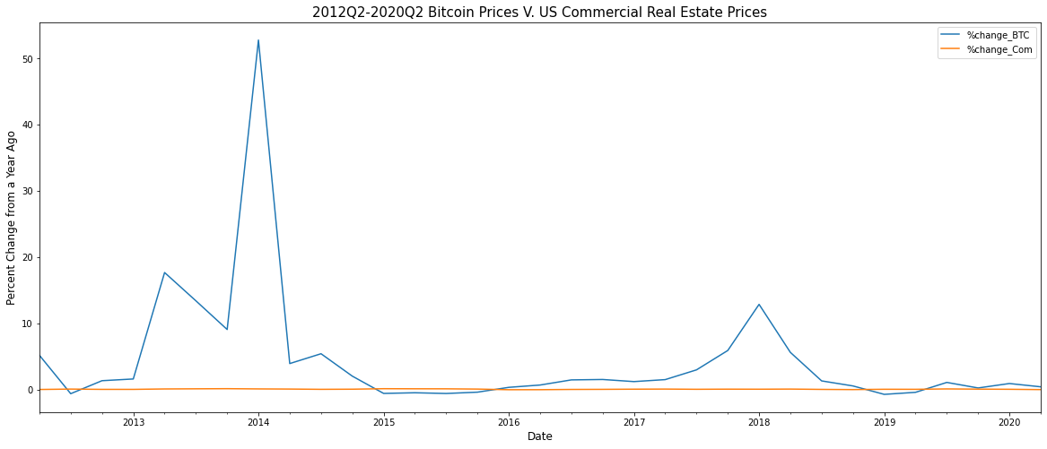
2012Q2-2020Q2 Bitcoin V. Commercial Real Estate

Slide 45
Bitcoin Stock To Flow Model
Price Predictions

Slide 46
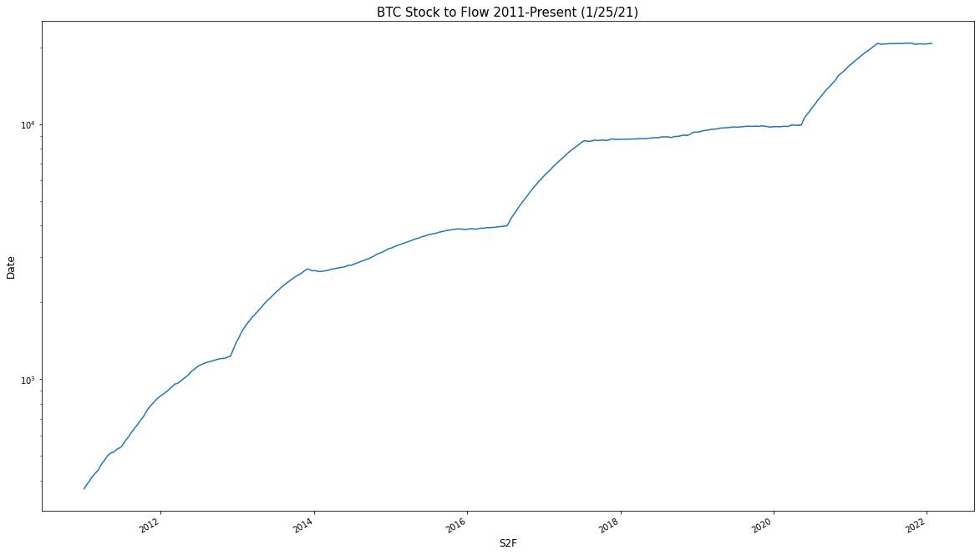
Stock to Flow
Stock to Flow for a monetary commodity like Bitcoin is defined as:
S2F=total cumulative inventory
÷
new daily supply
We then use the 365 Day moving average on the chart.

Slide 47
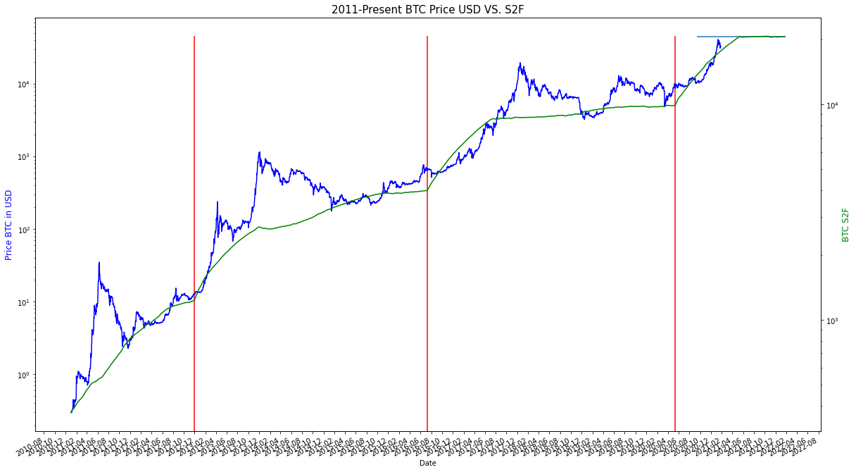
Stock to Flow Price BTC Overlay

Slide 48
Fin

